Slide 1
Introduction to Forensic Science and Law
Forensic science, also known as criminalistics, is the application of science to criminal and civil laws.
During criminal investigation in particular, it is governed by the legal standards of admissible evidence and criminal procedure.
It is a broad field utilizing numerous practices such as the analysis of DNA, fingerprints, bloodstain patterns, firearms, ballistics, and toxicology.
Forensic scientists collect, preserve, and analyze scientific evidence during the course of an investigation. While some forensic scientists travel to the scene of the crime to collect the evidence themselves, others occupy a laboratory role, performing analysis on objects brought to them by other individuals.
Still others are involved in analysis of financial, banking, or other numerical data for use in financial crime investigation, and can be employed as consultants from private firms, academia, or as government employees.
In addition to their laboratory role, forensic scientists testify as expert witnesses in both criminal and civil cases and can work for either the prosecution or the defense. While any field could technically be forensic, certain sections have developed over time to encompass the majority of forensically related cases.

Slide 2
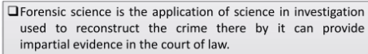
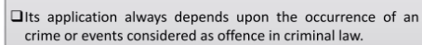


Slide 3
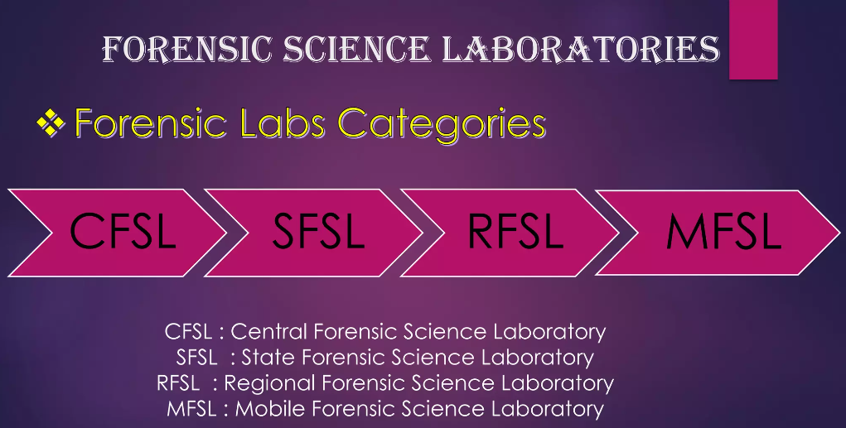

Slide 4
Forensic Science Laboratories category in India
Chemical Examiner Laboratory:
Initially The laboratories were known by this name
Central Forensic Science Laboratory (CFSL):
Under the control of DFSS Directorate forensic Sciences Services , MHA
State Forensic Science Laboratory (SFSL):
Established at state under the control of CFSL
Regional Forensic Science Laboratory (RFSL):
Established at the regional or district level under the control of SFSL
Mobile Forensic Science Laboratory (MFSL):
MobileVan for Rapid analysis of crime scene under control of SFSL or MFSL
Government Examiner of Questioned Document (GEQD) for Question Document Examination under CFSL or SFSL

Slide 5
forum
mid-15c., "place of assembly in ancient Rome," from Latin forum "marketplace, open space, public place," apparently akin to foris, foras "out of doors, outside," from PIE root *dhwer- "door, doorway." Sense of "assembly, place for public discussion" first recorded 1680s.
forensics plural in form but singular or plural in construction : the art or study of argumentative discourse

Slide 6
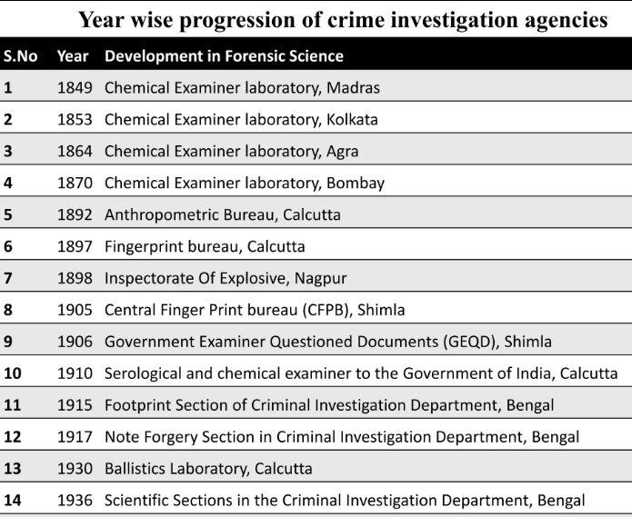

Slide 7
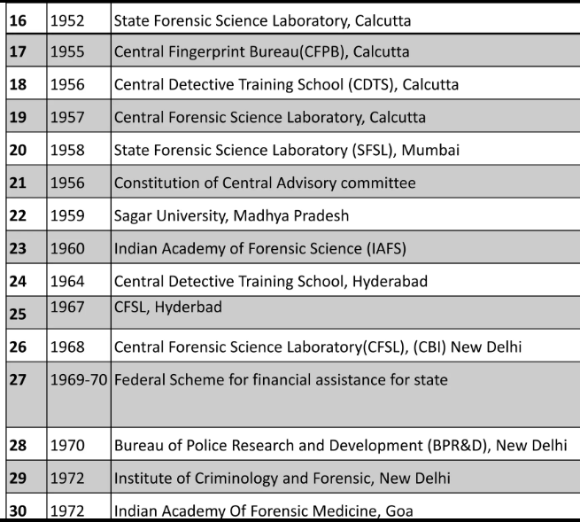

Slide 8
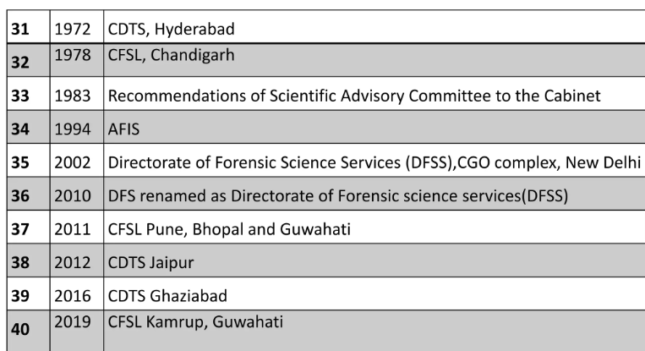

Slide 9
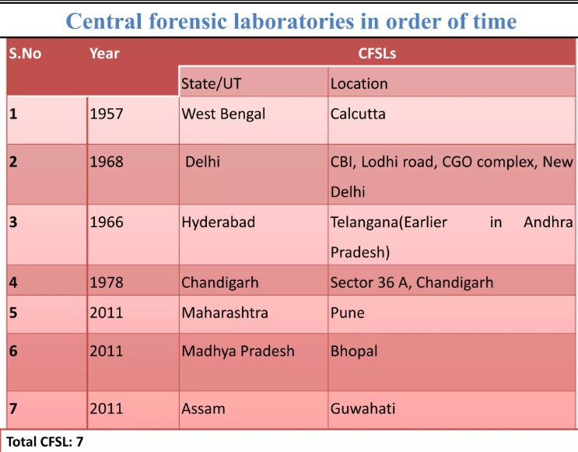

Slide 10
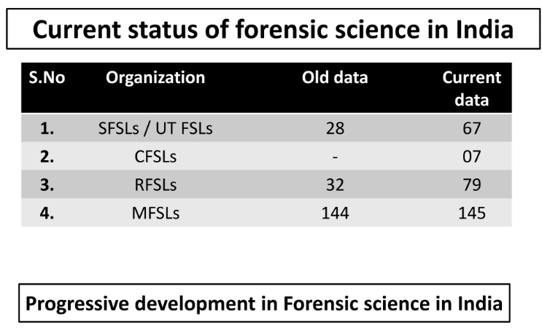

Slide 11
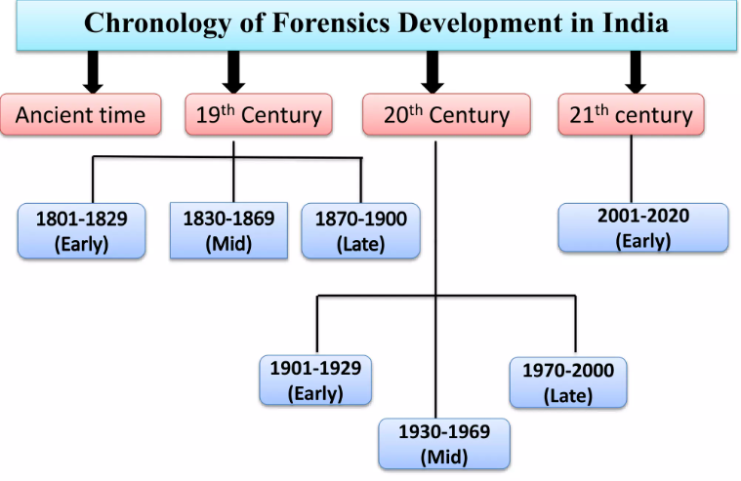

Slide 12
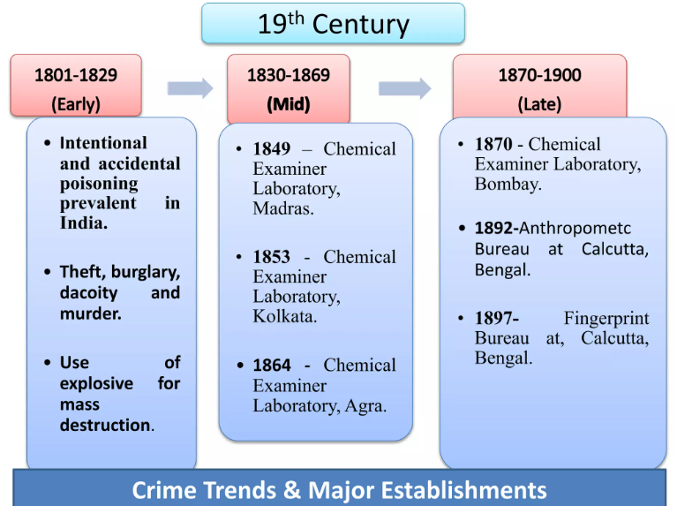

Slide 13
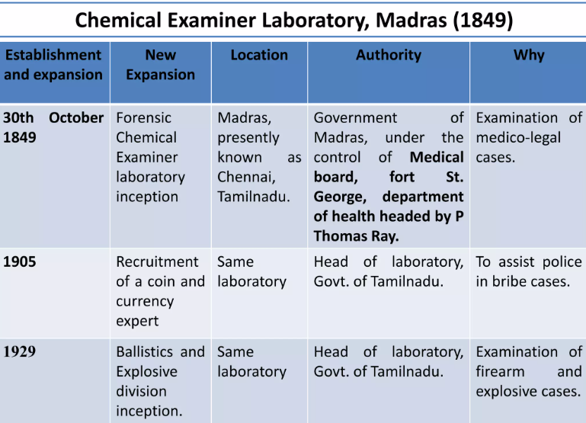

Slide 14
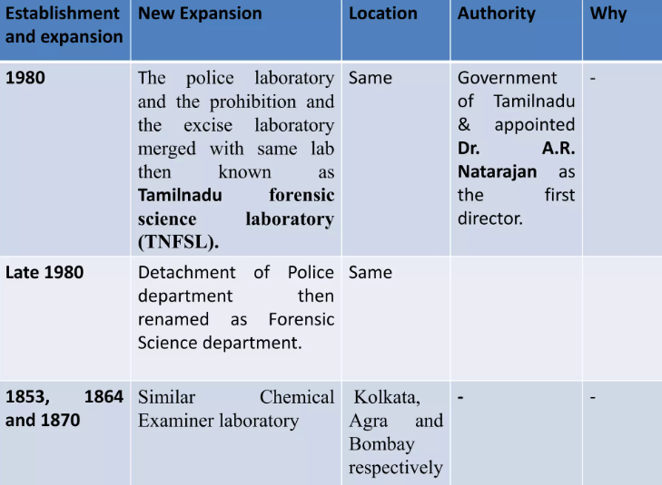

Slide 15
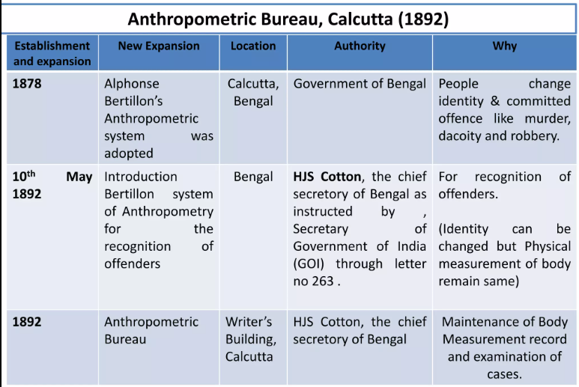

Slide 16
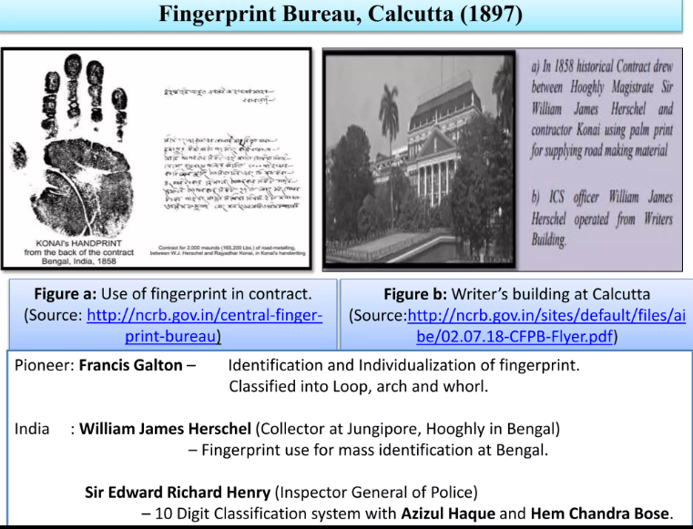

Slide 17
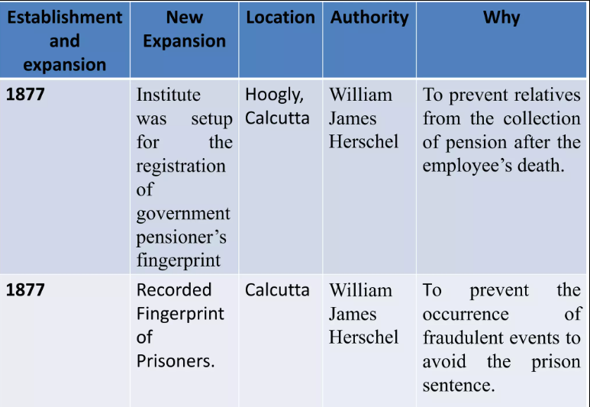

Slide 18
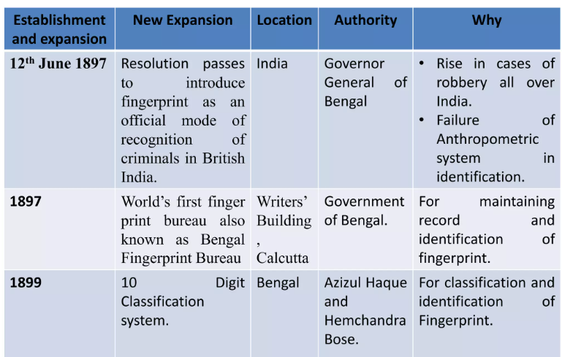

Slide 19
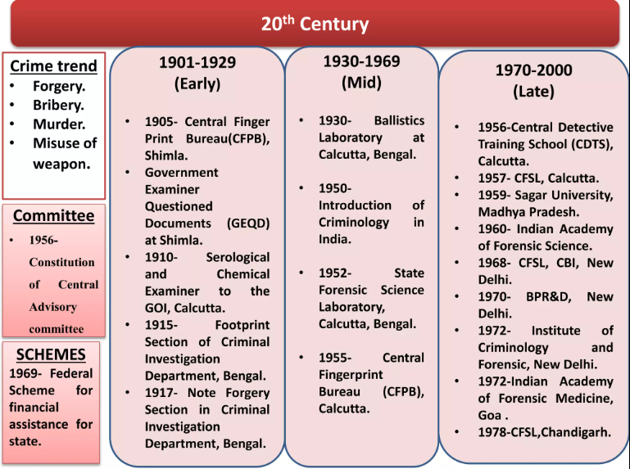

Slide 20
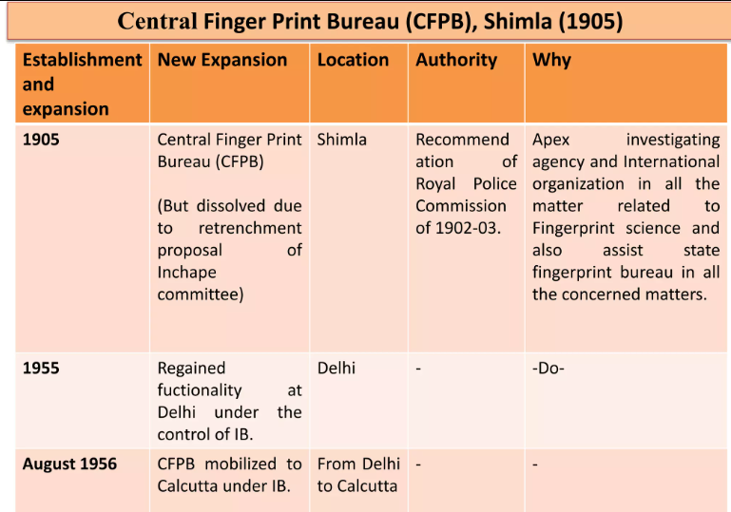

Slide 21
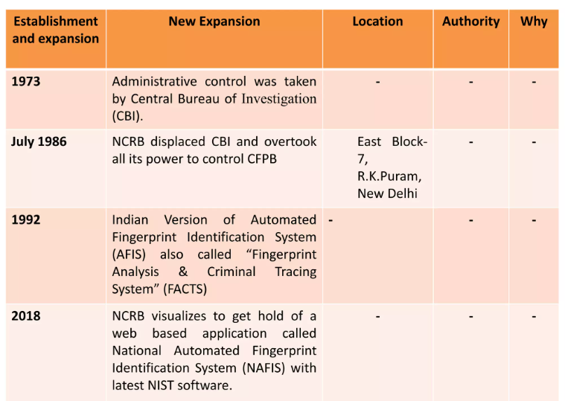

Slide 22
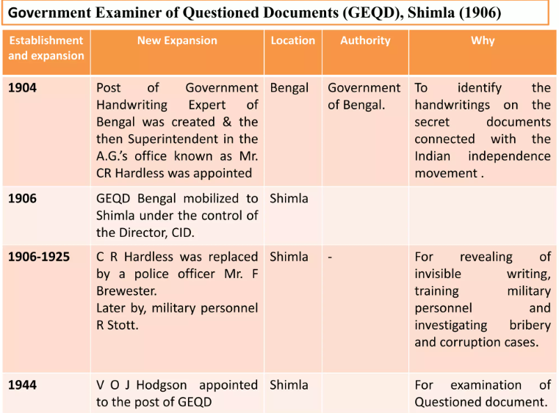

Slide 23
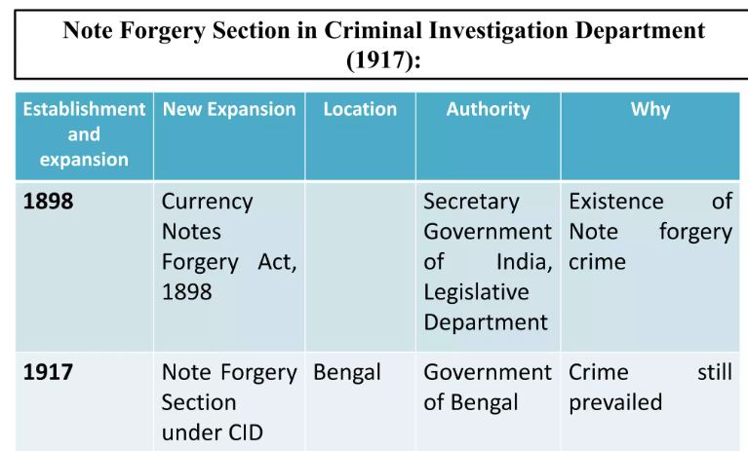

Slide 24
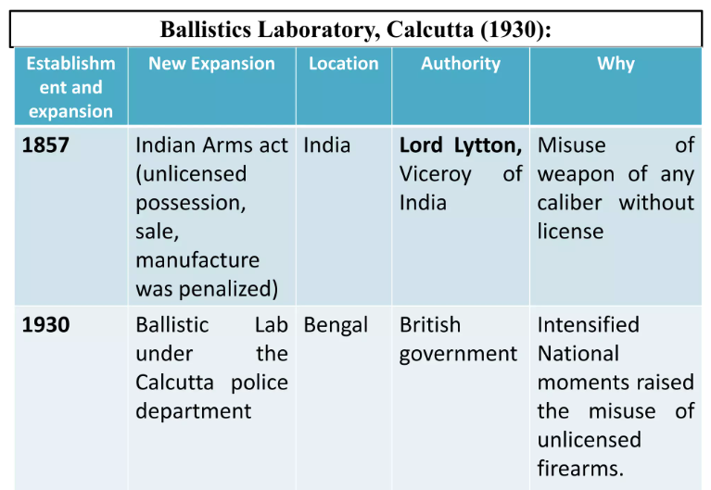

Slide 25
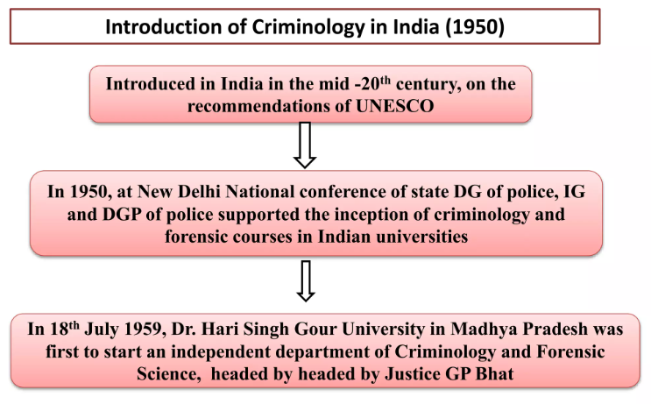

Slide 26
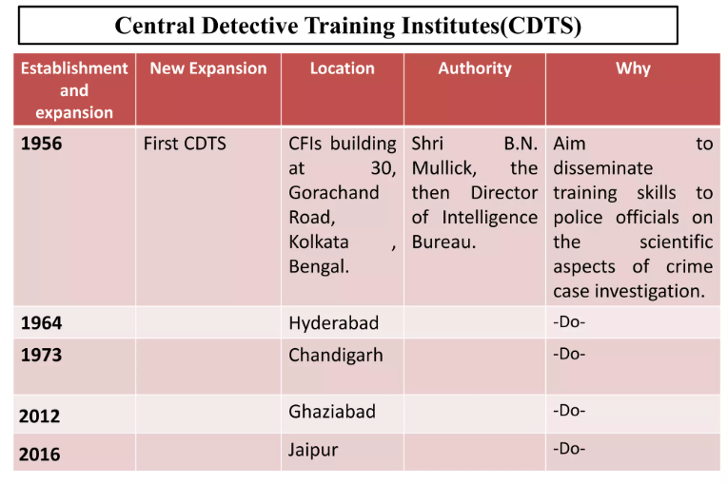

Slide 27
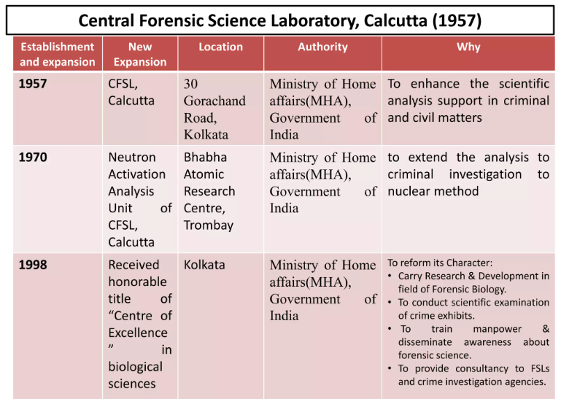

Slide 28
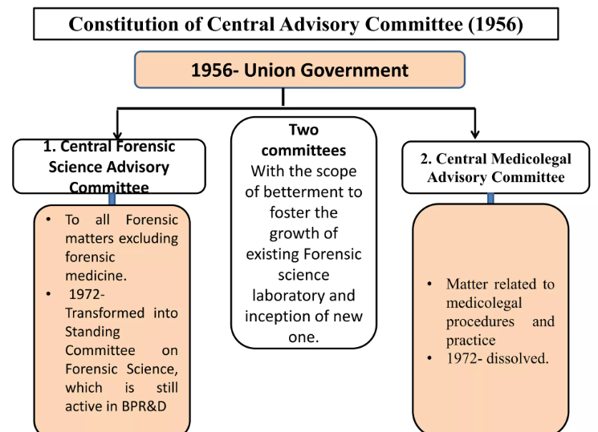

Slide 29
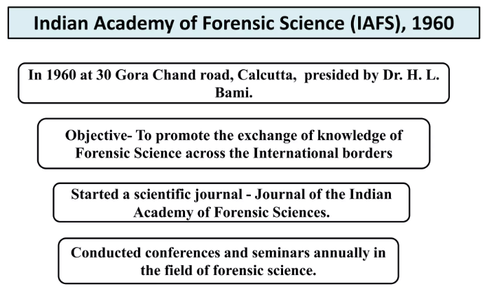

Slide 30
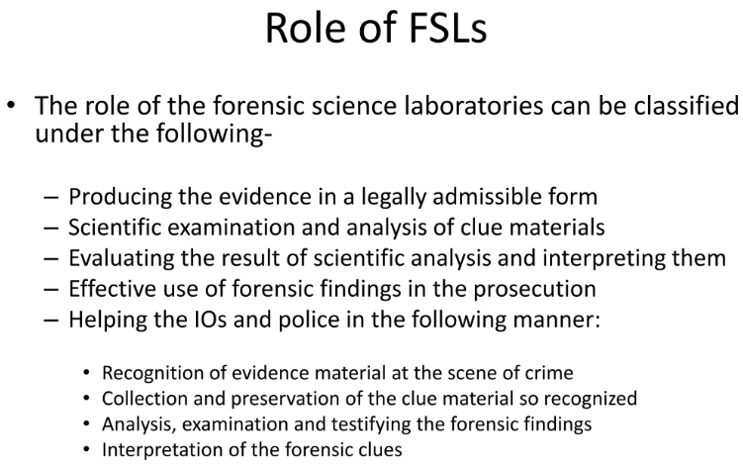

Slide 31
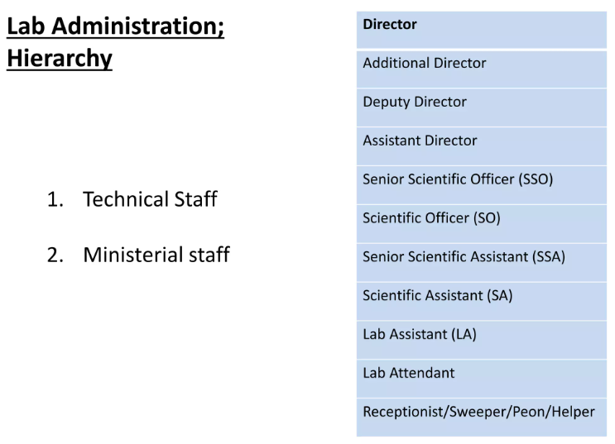

Slide 32
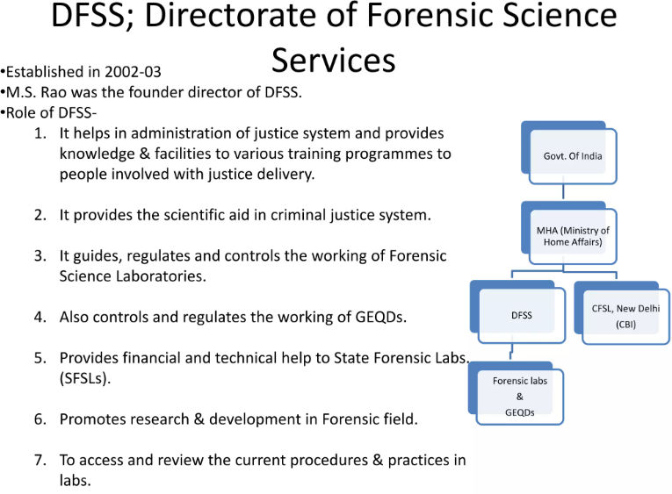

Slide 33
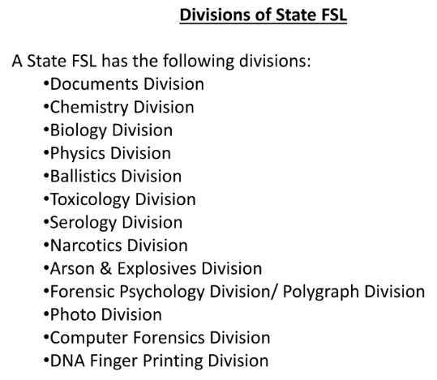

Slide 34
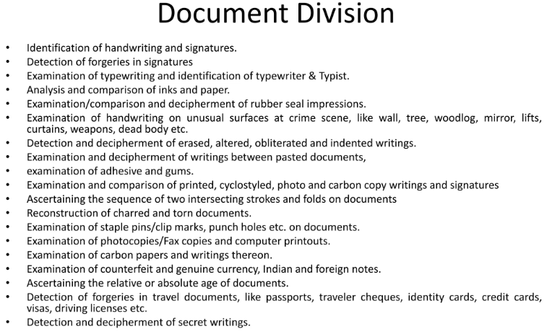

Slide 35
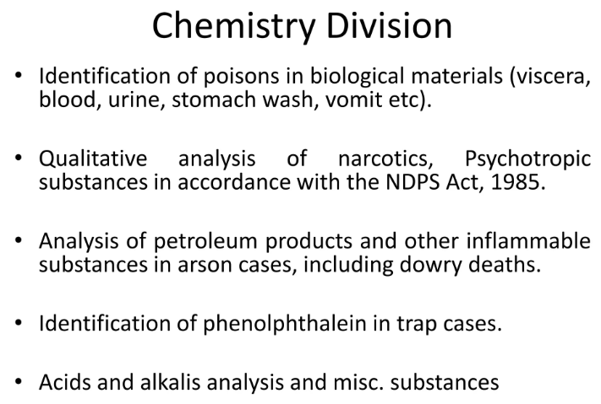

Slide 36
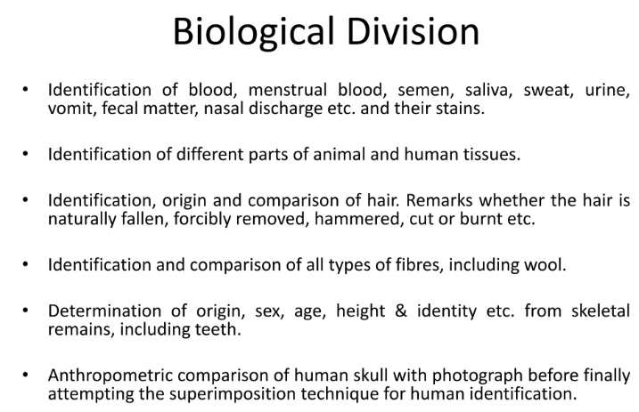

Slide 37
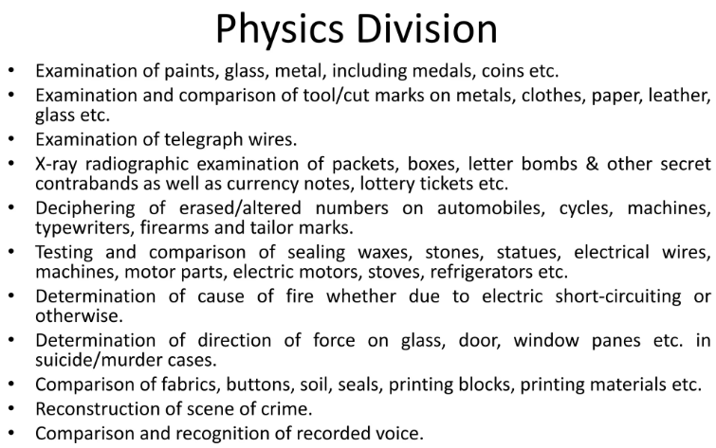

Slide 38
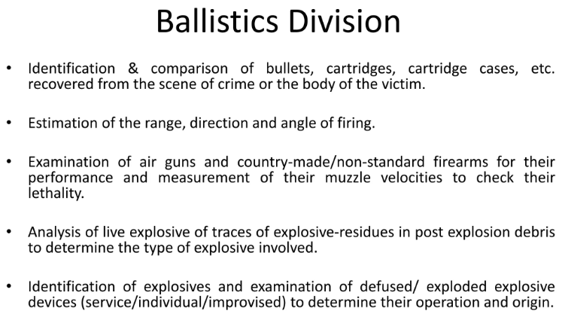

Slide 39
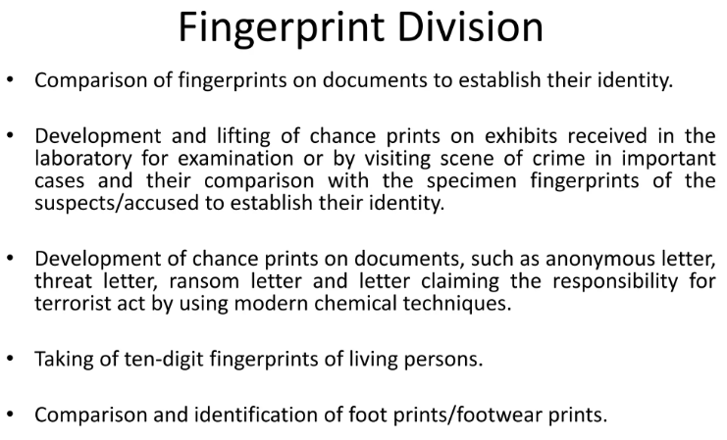

Slide 40
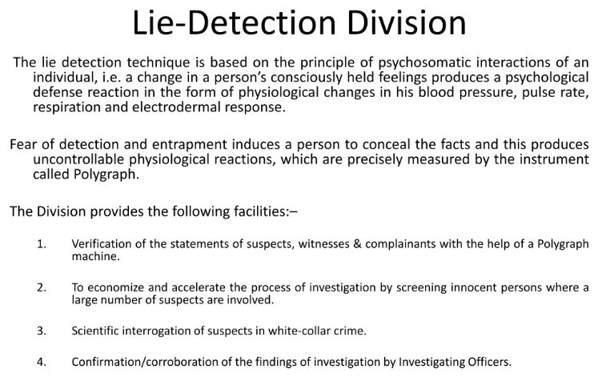

Slide 41
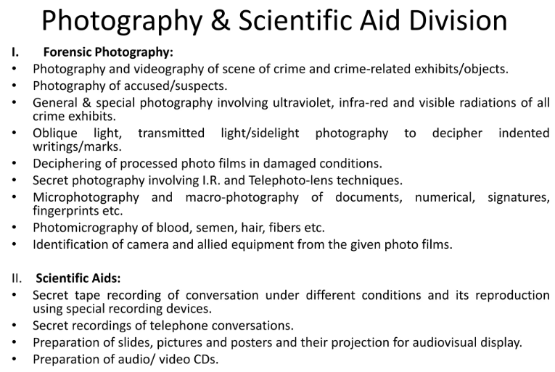

Slide 42
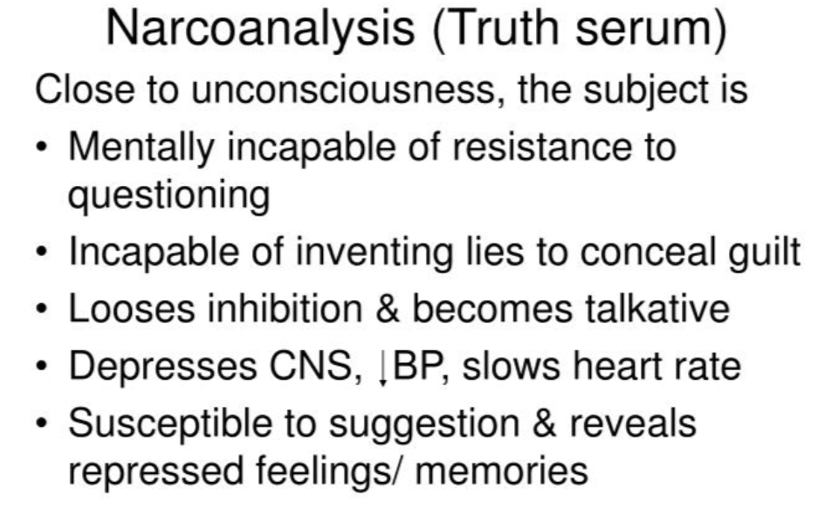
Sodium Pentathol and Sodium Amitel

Slide 43
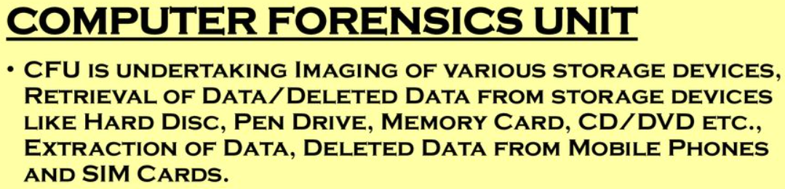
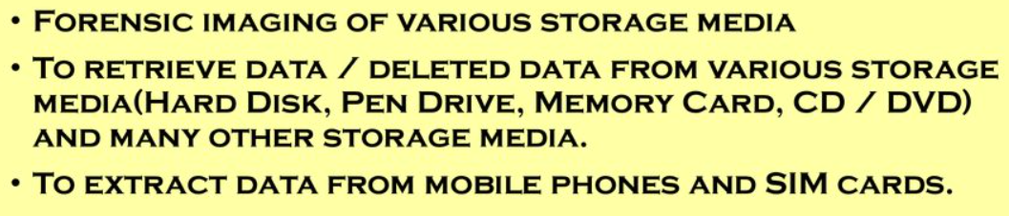
UFED, .XRF, Mobile forensic, Oxygen, ENCASE, FTK, Mobile Edit

Slide 44
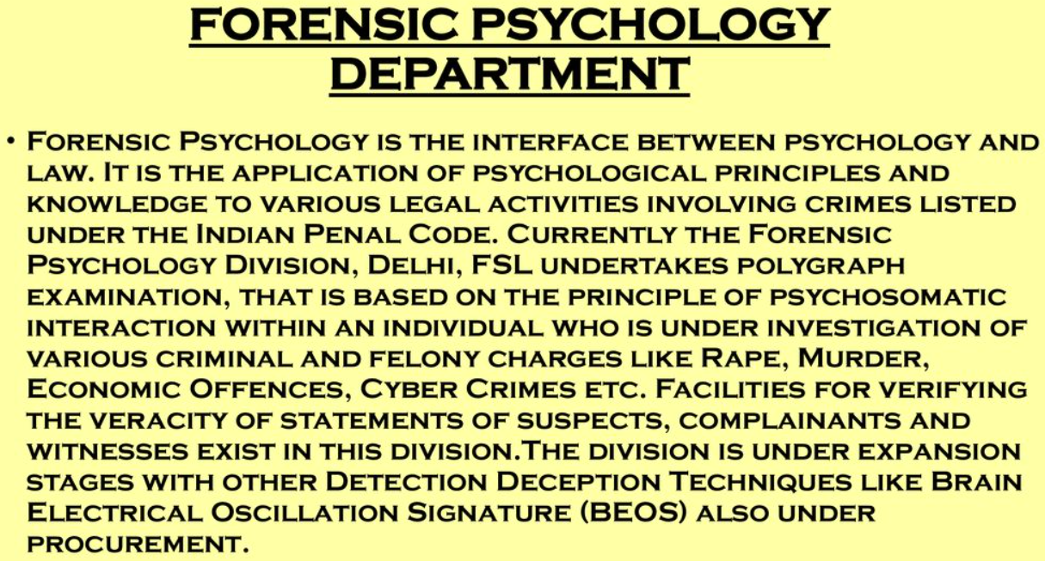

Slide 45
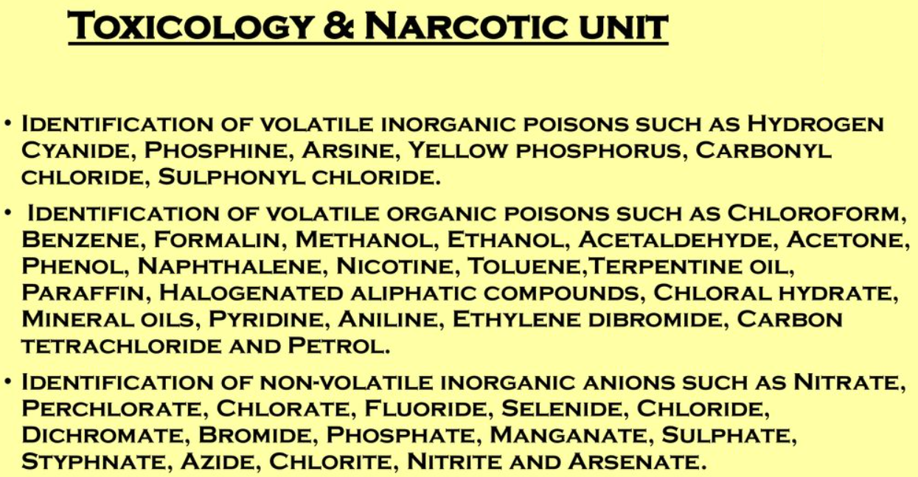

Slide 46
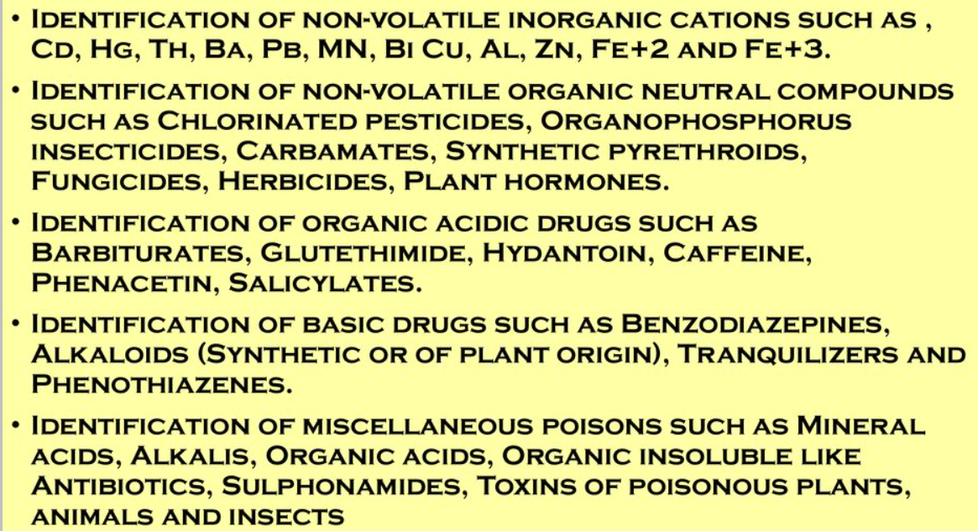

Slide 47
Functions of forensic science
Forensic science is a science that is used to help solve crimes and help give law enforcement an advantage in finding evidence to lead to the correct person who was responsible of the crime. It also helps create the scene for people to know what went on at the crime scenes.
Locard's Exchange Principle can be considered one of the basic concepts in Forensic Science because it reveals the main aspect of how forensic science work which is “every contact leaves it trace”.
The significances of this is that everything at the crime since can either give links to the victim or give clues to the suspect, meanwhile it also shows how the victims can be connected to the suspect.
By doing so, it allows forensic scientist to gather physical evidences to help them and other law informants to understand exactly who, what, when, how, and maybe even why a certain crime was committed. Another function of a forensic scientist is to actually analyze and maybe even experiment on physical evidences, to determine exactly what physical evidences something is or maybe pieces together significant information.

Slide 48
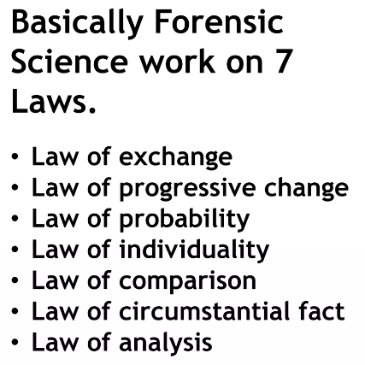

Slide 49
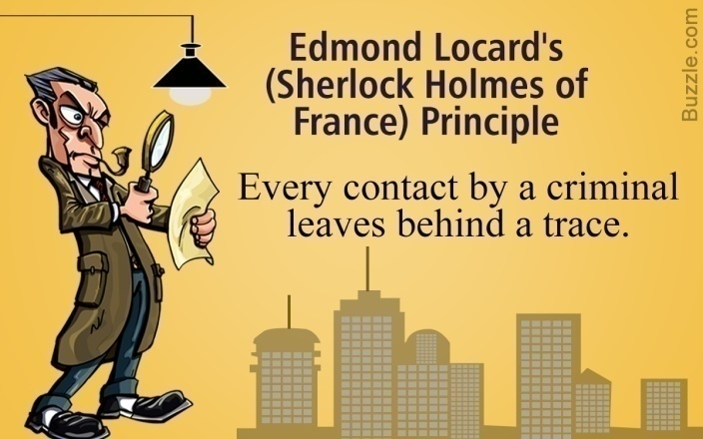
Principles Of Forensic Science
The principles of forensic science guide the disciplines and methodologies of science in analysing the evidence to answer certain questions. These principles of forensic science have an impact upon criminal proceedings which start from the point of investigation upon the occurrence of a crime till the conviction of the accused in the court of law. The principles of forensic science which are significant in criminal proceedings are as follows:
Locards Principle: Sir Adman Locardo, a pioneer in criminology and forensic science, gave the basic principle of forensic science every contact leaves a trace. This principle holds that the perpetrator of a crime will bring something into the crime scene and leave with something from it. This principle is associated with the trace evidence collection at the crime scene
When Two Objects come in Contact there is always exchange of materials.
Dr Edmond Locard (1877–1966), a criminologist.

Slide 50
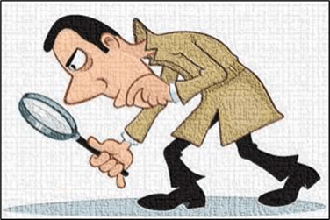
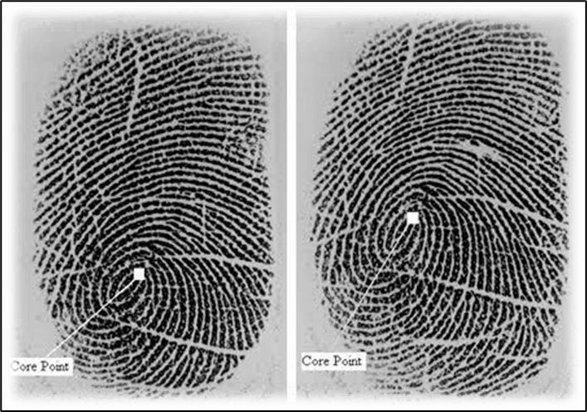
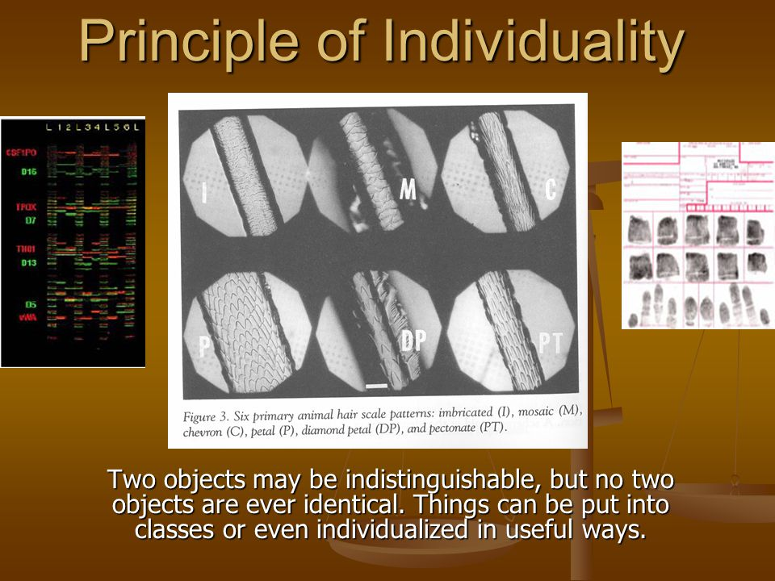
Law of individuality: Every object individual, natural or manmade, has a distinct quality or characteristic which is not duplicated in any other form or Object.
The most distinctive character associated with law of individuality is fingerprints which has a judgemental role in forensic science.

Slide 51
Law of exchange: Law of exchange states that when a criminal or his instrument comes in contact with the victim or the objects surrounding him he leaves some trace behind so that these traces are helpful for investigation purposes.
Law of progressive change: It states that everything changes with the passage of time and its impact on criminal investigation is immense because the crime scene and the criminal undergo changes and sometimes become unrecognizable.
Law of comparison: This principle compares only the people with similar likes whereas people having dissimilar likes are not compared.
Law of analysis: It means collection of the correct samples and their preservation for better analysis. The evidences have to be preserved in the prescribed manner to avoid tampering and destruction.
Law of probability: All the identifications and identities are sometimes consciously and unconsciously correct based on circumstances.

Slide 52
Law of circumstantial facts: Facts never lie but men can lie. Facts cannot be wrong, it cannot lie, it cannot be wholly absent. Therefore the importance of circumstantial facts is good for oral evidence.
Thus Forensic Science is that scientific discipline which is directed to the recognition, identification, individualization and evaluation of physical evidence by the application of the principles and methods of natural sciences for the purposes of administration of criminal justice.

Slide 53


Slide 54


Slide 55


Slide 56


Slide 57


Slide 58


Slide 59


Slide 60


Slide 61
Tools and Techniques in Forensic Science
Measurements
Microscopy
Photography
Invisible Ray
Chromatography
Electrophoresis
Spectrography
Laser Microprobe
Mass Spectrometry
Spectrophotometry
Neutron Activation Analysis
X-ray Diffraction Analysis
TGA, DTA , NMR and Polarography
Scanning Electron Microscopy

Slide 62




Examination of Clue Materials
Dimensions
Length, Breadth, Height, Depth, Curvature and Diameter
Melting point
Boiling Point
Densities
Refractive Indices
Birifrenges
Fluorescence

Slide 63


Microscopy
Compounds Microscope
Stereo Microscope
Comparison Microscope
Phase contrast Microscope
Metallurgical Microscope
Fluorescence Microscope
IR Microscope
Electron Microscopy Microscope

Slide 64



Slide 65


Slide 66



Slide 67



Slide 68


